Slide 1

Unit -3

Slide 2
Overview
Association Rule Mining
Types of ML Algorithm
Classification vs Regression
Linear Regression & Logistic Regression
K-Nearest Neighbors(k-NN)
Decision Tree – Naïve Bayes
Ensemble Method Random Forest
Feature – Generation and Selection
Filters, Wrappers

Slide 3
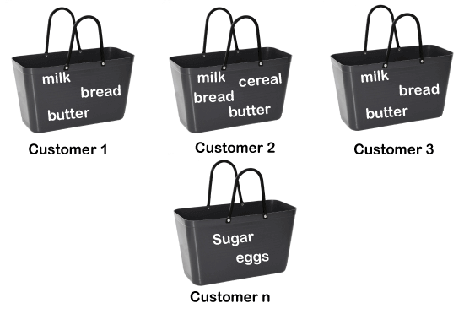
Association Rule Learning
Association rule learning is a type of unsupervised learning technique. It tries to find some interesting relations or associations among the variables of dataset. It is based on different rules to discover the interesting relations between variables in the database.
Application : Market Basket analysis,
Web usage mining, etc,

Slide 4

How does Association Rule Learning work?
Association rule learning works on the concept of If and Else Statement, such as if A then B.
Here the If element is called ANTECEDENT, and then statement is called as CONSEQUENT.
These types of relationships where we can find out some association or relation between two items is known as single cardinality.

Slide 5
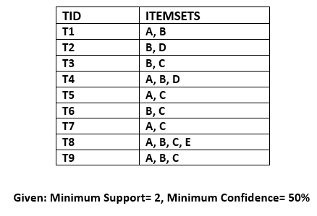
To measure the associations between Multiple of data items following metrics used.
Support
Confidence
Lift
B->C
Supp(x,y) = freq(x,y)/T

Slide 6
Lift Indicates
If Lift= 1: The probability of occurrence of antecedent and consequent is independent of each other.
Lift>1: It determines the degree to which the two itemsets are dependent to each other.
Lift<1: It tells us that one item is a substitute for other items, which means one item has a negative effect on another

Slide 7
Basics of Machine Learning Algorithms
Machine Learning (ML) is a subset of artificial intelligence that involves training computers to learn from data without being explicitly programmed. This learning process allows machines to identify patterns, make predictions, and perform tasks that would typically require human intervention.
Key Components of a Machine Learning Algorithm
Data: The raw material for ML algorithms. It can be structured (e.g., CSV files) or unstructured (e.g., images, text).
Features: The relevant attributes or characteristics extracted from the data.
Model: A mathematical representation that learns a mapping function between the features and the target variable.
Algorithm: The procedure or method used to train the model.

Slide 8
Types of Machine Learning Algorithms
Supervised Learning:
Regression: Predicting a continuous numerical value (e.g., house prices).
Ex- Linear regression, logistic regression, decision trees, random forests.
Classification: decision trees. random forests, neural networks.
Unsupervised Learning:
Clustering: Grouping data points into similar clusters.
Ex- K-means clustering, hierarchical clustering, DBSCAN.
Reinforcement Learning: Learning through trial and error, interacting with an environment and receiving rewards or penalties.

Slide 9
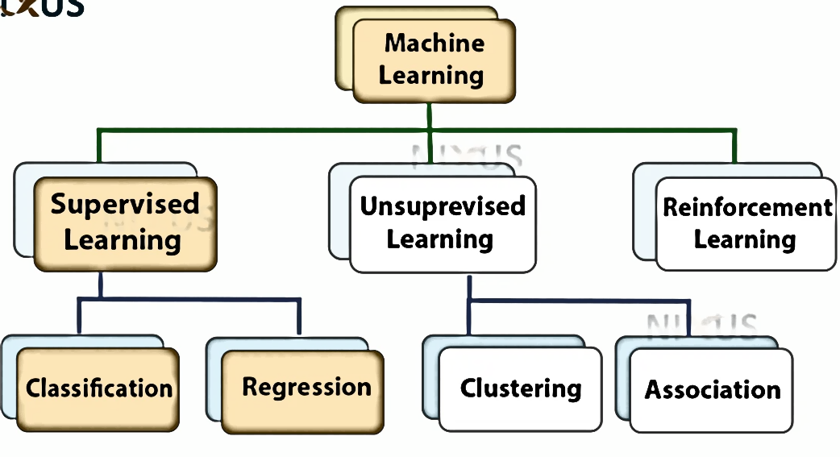
Types of ML Algorithms

Slide 10
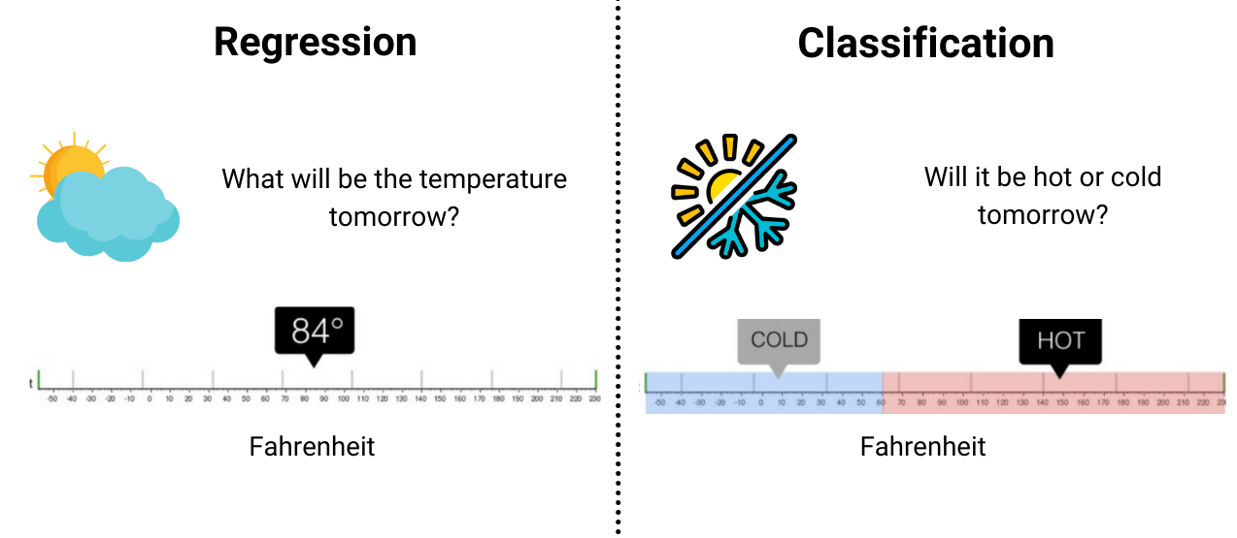
Regression vs Classification
Linear regression is used to predict the relationship between two variables by applying a linear equation to observed data. Linear regression is commonly used for predictive analysis.
The main idea of regression is to examine two things.
First, does a set of predictor variables do a good job in predicting an outcome?
Second, which variables are significant predictors of the outcome variable?

Slide 11
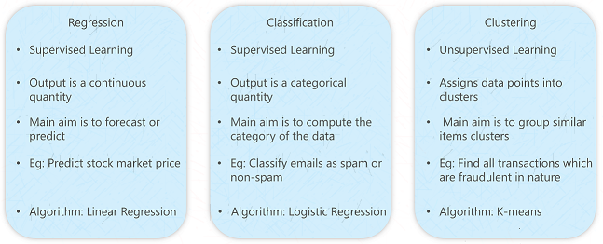
Regression vs Classification vs Clustering

Slide 12
Types of Regression Algorithms
Linear regression
Random Forest regression
Decision Tree regression
Use cases of Regression
Age prediction
Weather prediction
Market trend prediction, etc.

Slide 13
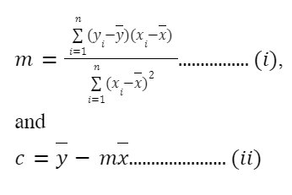
Linear Regression
Linear regression is used to predict the relationship between two variables by applying a linear equation to observed data. Linear regression is commonly used for predictive analysis.
The main idea of regression is to examine two things.
First, does a set of predictor variables do a good job in predicting an outcome?
Second, which variables are significant predictors of the outcome variable?

Slide 14
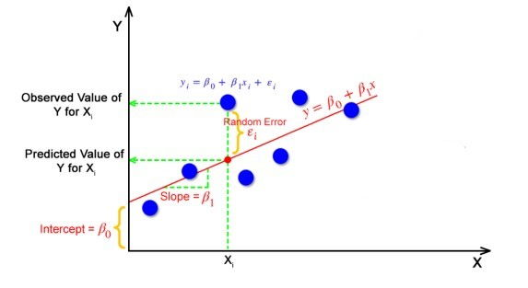
B0 = C B1 = m y=mx+c

Slide 15
LR – Practical Manual
import numpy as np
import matplotlib.pyplot as plt
# Given data
x = np.array([1500, 1600, 1700, 1800, 1900])
# Square Footage
y = np.array([245, 312, 279, 308, 335])
# Prices in thousands of dollars
# Calculating the means of x and y
mean_x = np.mean(x)
mean_y = np.mean(y)
# Calculating slope (m) and intercept (c)
m = np.sum((x - mean_x) * (y - mean_y)) / np.sum((x - mean_x) ** 2)
c = mean_y - m * mean_x
print(f"Slope (m): {m}")
print(f"Intercept (c): {c}")
# Predicting prices using the linear regression model
y_pred = m * x + c
# Calculating Mean Squared Error (MSE)
mse = np.mean((y - y_pred) ** 2)
print(f"Mean Squared Error (MSE): {mse}")
plt.scatter(x,y)
plt.plot(x,y_pred)
plt.show()

Slide 16
Linear Regression using sklearn lib
from sklearn.model_selection import train_test_split
from sklearn.linear_model import LinearRegression
# load titaninc dataset
df = df.dropna()
x=df.Age
y=df.Fare
x_train,x_test,y_train,y_test=train_test_split(x,y,test_size=0.2,random_state=2)
lr = LinearRegression()
lr.fit(x_train.values.reshape(146,1),y_train.values.reshape(146,1)) #numer of row : 146
y_pred=lr.predict(x_test.values.reshape(37,1))
plt.scatter(x_test,y_test)
plt.plot(x_test,y_pred , c='red')
plt.title("Actual vs. Predicted Fares")
plt.show()

Slide 17
Types of classification Algorithms
Logistic Regression
K-Nearest Neighbours
Naive Bayes
Decision Tree classification
Random Forest classification
Use cases of Classification
Email spam detection
Disease Detection
Speech Recognition
Face recognition, etc

Slide 18
Classification Problem : Logistic Regression
1
Obese
0
weight

Slide 19
LogisticRegression – using Sklearn
import numpy as np
from sklearn.linear_model import LogisticRegression
import matplotlib.pyplot as plt
# Data: Hours studied (X) and whether the student passed (Y)
X = np.array([[1], [2], [3], [4], [5], [6], [7]])
# Hours studied
Y = np.array([0, 0, 0, 1, 1, 1, 1])
# Pass (1) or Fail (0)
# Initialize the logistic regression model
model = LogisticRegression()
# Fit the model
model.fit(X, Y)
x_test=np.linspace(0,8,10).reshape(10,1)
Prob_passing = model.predict_proba(x_test)[:,1]
plt.scatter(X, Y, color='red', label='Data points')
plt.plot(x_test, Prob_passing, color='blue', label='Logistic Regression Curve')
plt.xlabel('Hours Studied')
plt.ylabel('Probability of Passing')
plt.title('Logistic Regression: Probability of Passing vs. Hours Studied')
plt.grid(True)
plt.show()

Slide 20
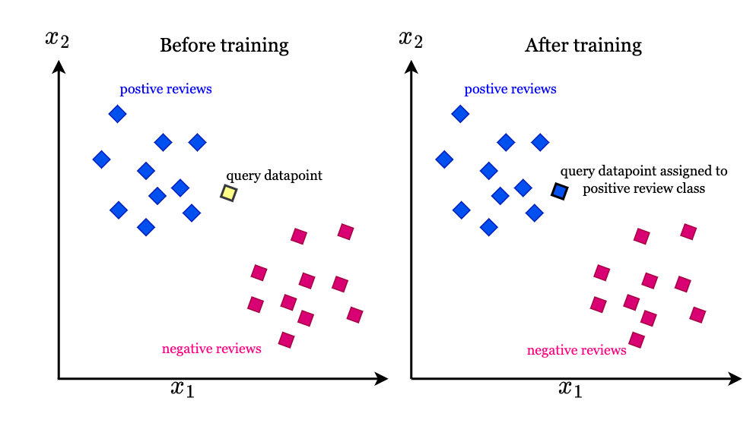
K-Nearest Neighbour
The k-nearest neighbors (KNN) algorithm is a supervised learning classifier, which uses proximity to make classifications or predictions about the grouping of an individual data point
import matplotlib.pyplot as plt
x = [4, 5, 10, 4, 3, 11, 14 , 8, 10, 12]
y = [21, 19, 24, 17, 16, 25, 24, 22, 21, 21]
classes = [0, 0, 1, 0, 0, 1, 1, 0, 1, 1]
plt.scatter(x, y, c=classes)
plt.show()

Slide 21
K-Nearest Neighbour
The value of k affects the model's error rate and performance:
Overfitting
A small value of k can cause overfitting, which means the model performs well on training data but poorly on new data.
Underfitting
A large value of k can cause underfitting, which means the model doesn't perform well on training data and can't be generalized to new data.
Ties
Choosing an odd value of k can help avoid ties in classification.
Here are some tips for choosing the value of k:
Square root of n: Choose k as the square root of the total number of data points.
Bootstrap method: In binary classification problems, the bootstrap method is a popular way to choose the optimal k.
Cross-validation: Use cross-validation to select the best value of k and improve performance.

Slide 22
K-Nearest Neighbour
USED For:
Data Preprocessing ( As simple Data Imputer – to handle null value)
Forecasting (Finance / Healthcare)
Advantage:
Easy to implement
Few Hyperparameter (Distance Matrix, k-value)
Adaptable
Disadvantage:
Scale ( require whole data so time taking process)
Curse of Dimensionality (add unnecessary column which might add noise)
Overfitting (on lower k values)
Underfitting (on higher k values)

Slide 23
K-Nearest Neighbour
from sklearn.neighbors import KNeighborsClassifier
data = list(zip(x, y)) // convert like [(4,5),(8,9)]
knn = KNeighborsClassifier(n_neighbors=1)
knn.fit(data, classes)
new_x = 8
new_y = 21
new_point = [(new_x, new_y)]
prediction = knn.predict(new_point) //[0] or [1] sklearn provide result in array
plt.scatter(x + [new_x], y + [new_y], c=classes + [prediction[0]])
plt.show()

Slide 24
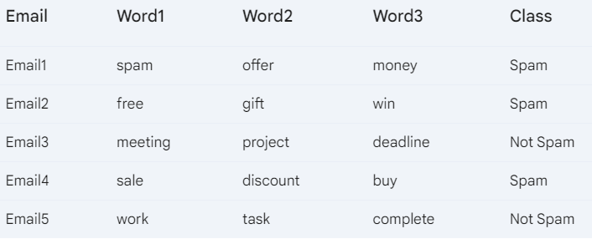
Naïve Bayes

Slide 25
Naïve Bayes
Step 1: Calculate Probabilities
Prior probabilities:
P(Spam) = 3/5 = 0.6
P(Not Spam) = 2/5 = 0.4
Step 2: Classify a New Email
New email: "free offer buy"
Calculate probabilities:
P(Class=Spam | Word1=free, Word2=offer, Word3=busy) =
P(Spam) * P(Word1=free | Spam) * P(Word2=offer | Spam) * P(Word3=buy| Spam)
P(Class=Not Spam | Word1=free, Word2=offer, Word3=busy) =
P(Not Spam) * P(Word1=free | Not Spam) * P(Word2=offer | Not Spam) * P(Word3=buy | Not Spam)
Compare probabilities and assign the class with the highest probability.

Slide 26
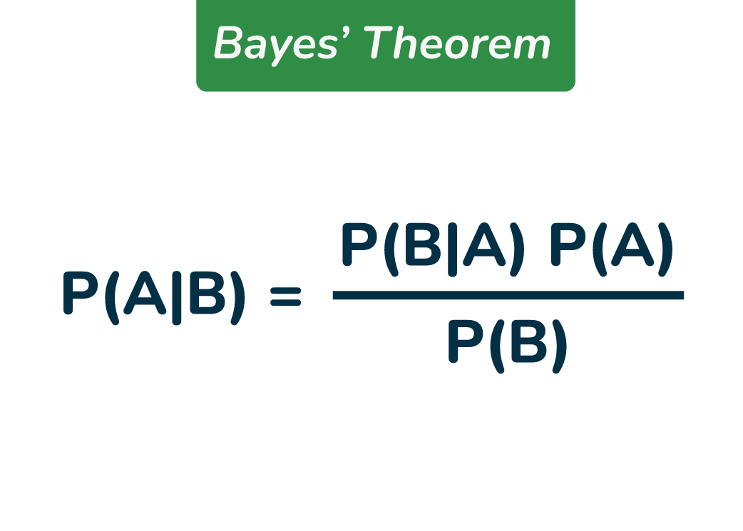
Naïve Bayes
Naive Bayes is a simple probabilistic classifier based on Bayes’ theorem.
It assumes that the features of a given data point are independent of each other, which is often not the case in reality.
Used in :
text classification. In text classification tasks, data contains high dimension (as each word represent one feature in the data).
spam filtering, sentiment detection, rating classification etc.

Slide 27
Naïve Bayes
Steps Involved in Naive Bayes
Data Preparation:
Collect and clean your data: Ensure the data is relevant and free from errors.
Split the data into training and testing sets: This helps evaluate the model's performance.
Calculate Probabilities:
Calculate the prior probability: This is the probability of each class occurring in the training set.
Calculate the conditional probability: This is the probability of a feature occurring given a particular class.
Make Predictions:
For a new instance, calculate the probability of it belonging to each class.
Assign the instance to the class with the highest probability.

Slide 28
Naïve Bayes
Steps Involved in Naive Bayes
Data Preparation:
Collect and clean your data: Ensure the data is relevant and free from errors.
Split the data into training and testing sets: This helps evaluate the model's performance.
Calculate Probabilities:
Calculate the prior probability: This is the probability of each class occurring in the training set.
Calculate the conditional probability: This is the probability of a feature occurring given a particular class.
Make Predictions:
For a new instance, calculate the probability of it belonging to each class.
Assign the instance to the class with the highest probability.

Slide 29
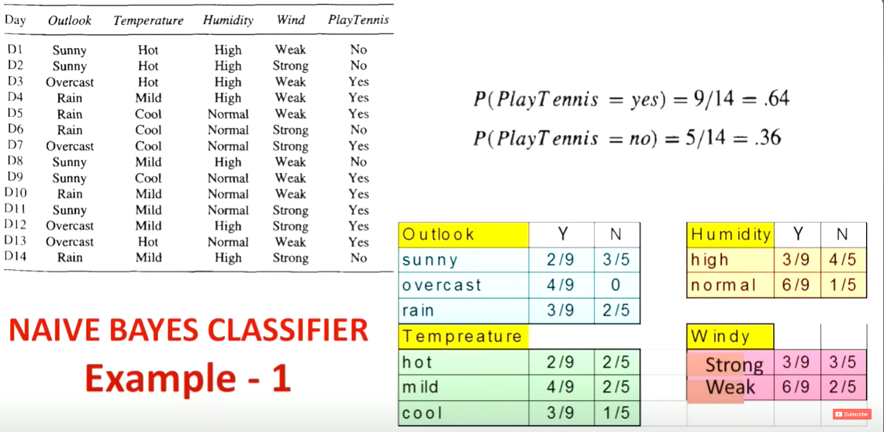

Slide 30
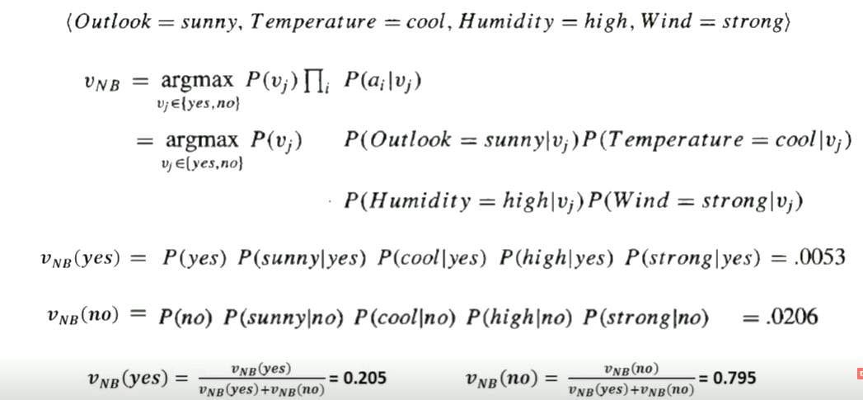

Slide 31
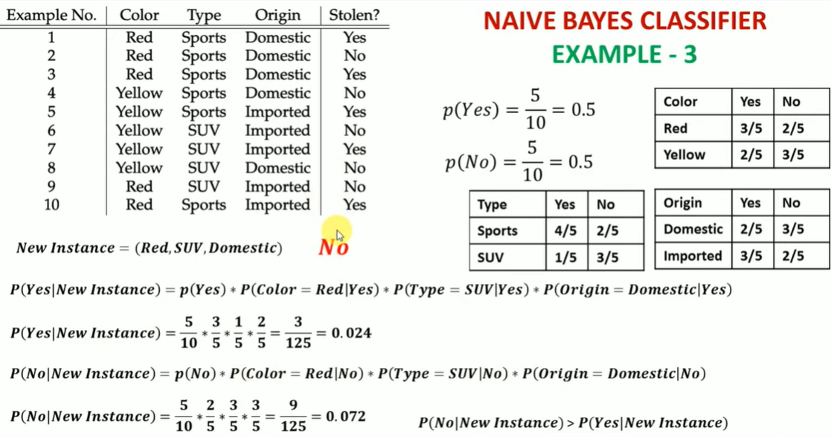

Slide 32
Naïve Bayes
Advantage:
Less complex: considered as simpler classifier since the parameters are easier to estimate.
Scales well: fairly accurate when the conditional independence assumption holds. It also has low storage requirements.
Can handle high-dimensional data: Use cases, such document classification, can have a high number of dimensions, which can be difficult for other classifiers to manage.
Overfitting is generally not a major concern with Naive Bayes. This is primarily due to its strong independence assumption.
Disadvantage:
Subject to Zero frequency: If categorical variable has a category (in test set), which was not observed in training data set, then model will assign a 0 (zero) probability and will be unable to make a prediction.
Unrealistic core assumption: In real life, it is almost impossible that we get a set of predictors which are completely independent.

